Slide 1
Code Audit
Coursework 2
Bill Byrne, Ellis Dann, Joseph Kemp, Maaria Kherouf
Group 3 | 5218COMP: Secure Software Development
Computer Science | Liverpool John Moores University
Notes:
ORDER OF PRESENTING: BILL
MAARIA
ELLIS
JOE

Slide 2
Audit Procedure
Self-Exploration & Observations
(Static Analysis)
The first step to our code audit, we performed a static analysis before looking at the code to see how the site operated and performed penetration testing and made notes from our observations.
Notes:
Discuss Static Analysis:
*Explored the site to see how it operates, functions, behaves
*Performed penetration testing to spot any initial vulnerabilities in the site
*Made Observations

Slide 3
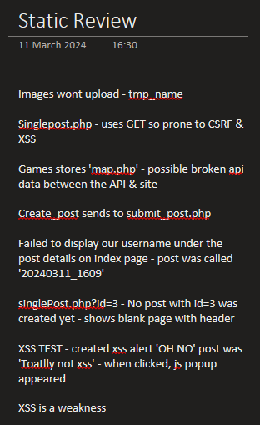
Audit Evidence: An Excerpt Of Our Observation Notes For Static Testing

Slide 4
Audit Procedure
Light Code Analysis (Pre-Scanner)
(Manual Review)
Next, we had a look at the source code of the website and analysed pages, starting off with pages that we had concerns about in the previous step as well as lightly looking over some of the other pages.
Notes:
For our manual review, we did a quick scan over all the code files to spot anything clearly obvious and ,make notes. We also looked at the code to pages that we had concerns about in our initial observations.

Slide 5
Audit Procedure
Code Vulnerability Scanners
(Dynamic Analysis)
We then decided to run our sites through a couple of scanners (OWASP & Visual Code Grapper)
This allowed us to pick up on issues that we didn’t find in the initial findings and allowed us to dig deeper further into out code.
We Then Analysed The Scanner Reports to get an understanding of the vulnerabilities in the site.
Notes:
After Our Static Testing, We Performed Our Dynamic Testing Using The Visual Code Graper & The OWASP To Detect Vulnerabilities We Didn’t spot in our initial analysis and give us a deep scan into our code. This gave us a really good insight into our code.

Slide 6
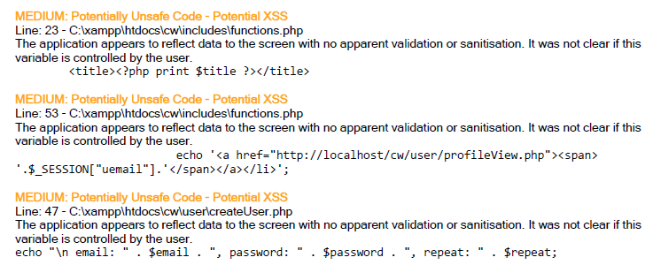
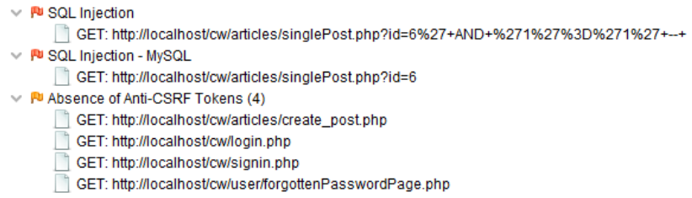
Audit Evidence: Security Scanner Reports From Dynamic Analysis
Notes:
Briefly Discuss The Reports
Visual Code Grapper (Top)
OWASP (Bottom)

Slide 7
Audit Procedure
Deep Code Analysis (Post-Scanner)
(Manual Review)
Following On From The Scanners We Had A Manual Review Deeply Analysing Code Files & Vulnerabilities Picked Up By The Scanner.
Notes:
Discuss About Our Deep Code Analysis Using Our Observations From The Static Testing & The Security Scanner Reports

Slide 8
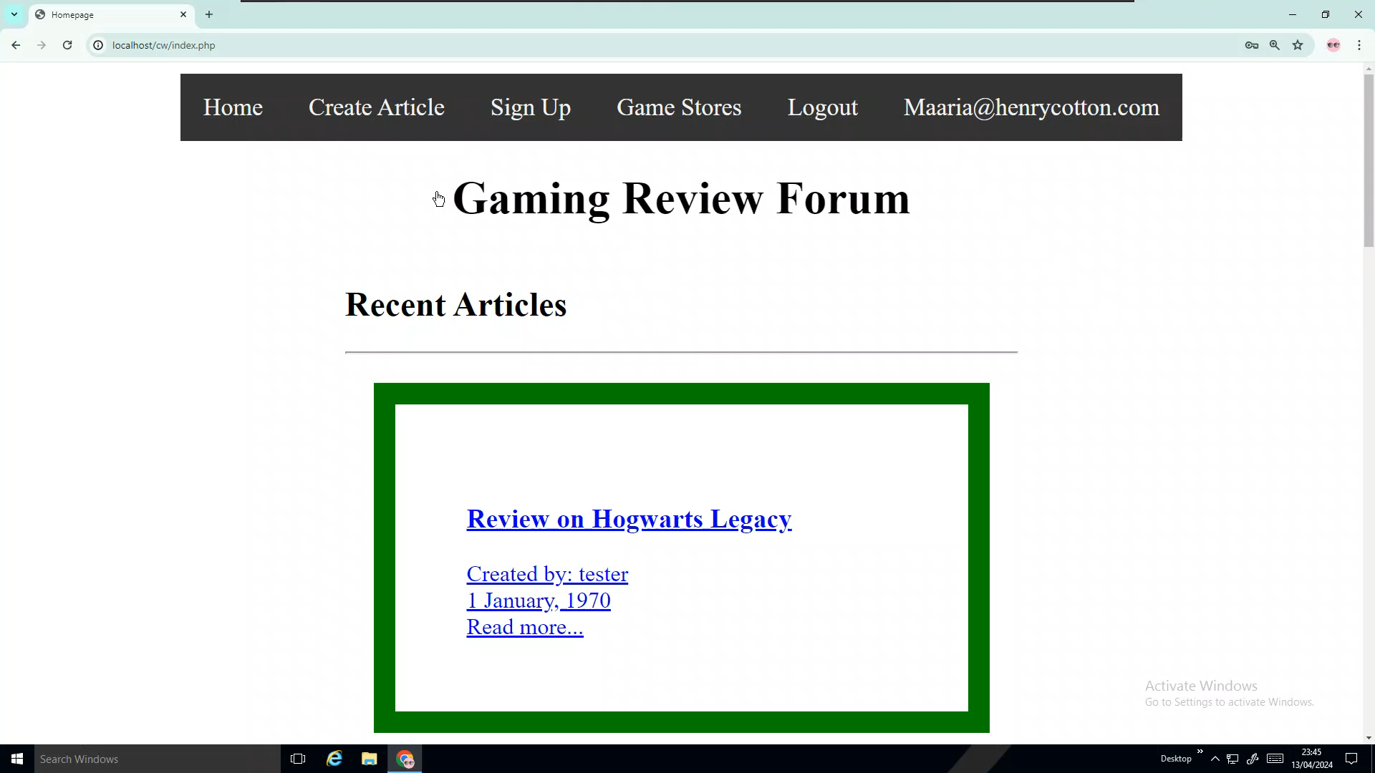
Cross Site Scripting (XSS)
Explanation
Evidence
When untrusted data is included on a page by a web application without sufficient input validation
Users can enter malicious scripts which will end up being executed when the site is run
A malicious script is provided as the post title, as seen by the proof on the right. Because there is insufficient input validation, the page opens and instantly redirects to fridge.com
Notes:
<EXPLAINATION POINTS>
DEFINITION: Cross-Site Scripting (XSS) is a security vulnerability in web applications that allows attackers to inject malicious scripts into web pages viewed by other users.
THREAT: attacker to inject code that is then executed in the context of the victim's browser, this can lead to malicious activities, such as stealing sensitive information & hijacking sessions
EVIDENCE: A malicious script is provided as the post title, as seen by the proof on the right. Because there is insufficient input validation, the page opens and instantly redirects to fridge.com.

Slide 9
SQL Injection
Explanation
Evidence
Is a vulnerability in online security that lets hackers change the queries that a programme sends to its database.
Attackers can use this to access, modify and delete data
In this case, if the variables like $title, $content, or $genre are directly taken from user input without proper sanitization, an attacker could potentially manipulate the SQL query to perform unauthorized actions on the database.
$sql = "INSERT INTO article (title, content, genre)
VALUES ('$title', '$content', '$genre')";
Notes:
Definition: enables hackers to alter the queries that a programme sends to its database due to a flaw in internet security.
THREAT: 1) manipulate the database 2) potentially gaining unauthorized access to sensitive information 3) modifying data
EVIDENCE: IN THIS EVIDENCE, IF THE VARIABLES LIKE $TITLE , $CONTENT , OR $GENRE ARE DIRECTLY TAKEN FROM USER INPUT WITHOUT PROPER SANITATIZATION, AN ATTACKER COULD POTENTIALLY MANIPULATE THE SQL QUERY TO PERFORM UNAUTHORISED ACTIONS ON THE DATABASE.

Slide 10
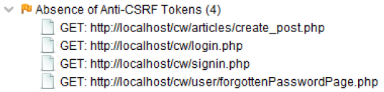
Cross-Site Request Forgery (CSRF)
Explanation
Evidence
An attack that takes place when a http request is sent to a target destination without the user's knowledge to perform unauthorised actions to the victim.
Examples of what can happen due to this include: changing account settings, making purchases, transferring funds, or even deleting data.
Snippet from the report found from the dynamic analysis, by the OWASP scanner. It Identifies 4 different pages from the site which do not use CSRF Tokens.
Notes:
DEFINITION: is a type of web security vulnerability where an attacker tricks a user's browser into making an unwanted request to a web application on which the user is authenticated.
<RISK>unauthorized actions being taken on behalf of the user, such as changing account settings, making purchases, transferring funds, or even deleting data. Since the request comes from a trusted user's browser, the target website may not be able to distinguish between a legitimate request and a forged one.
EVIDENCE: Snippet from the report found from the dynamic analysis, by the OWASP scanner. It Identifies 4 different pages from the site which do not use CSRF Tokens.

Slide 11
Vulnerabilities
The Two Vulnerabilities We Decided To Closely Look At And Fix For This Assignment Were:
XSS
CSRF

Slide 12
XSS Vulnerability
Cross-site scripting (XSS) allows attackers to inject malicious scripts into web pages viewed by other users.
These scripts can steal sensitive information, manipulate or deface web content, redirect users to malicious websites, and perform other harmful actions.
XSS attacks exploit the trust a user has in a website by executing unauthorized code within their browser.
Notes:
Made possible when user inputs displayed
Other users run these scripts unknowingly
can steal information, redirect users
Very bad because it ruins trust from users

Slide 13
Cross-Site Request Forgery (CSRF)
Cross-Site Request Forgery (CSRF) is where malicious actors manipulate a user's authenticated session on a website without consent.
Achieved by tricking the user into clicking on a specially crafted link or visiting a malicious website, which then initiates requests to the website using the user's existing credentials.
These requests can execute actions such as changing account settings, making purchases, or transferring funds.
Notes:
Where attackers trick user into clicking link or visiting a malicious website
can make requests using users credentials
Attackers can change account settings, buy things or transfer funds

Slide 14
The Fixes
XSS
CSRF
Input validation can be done through input sanitisation. A very common way of doing this is by using input encoding
e.g., from “<“ to “&lt” and “>”” to “&gt”
Inputs should be sanitised before being entered into a database, being retrieved from a database and whenever an input is outputted onto the site
POST should be used instead of GET in query strings
CSRF tokens are a large random value that is used to ensure that the request comes from a genuine source. These should be unique to the session
Headers can also be checked for their source and destination using standard HTTP headers which only browsers can do
Notes:
Input validation (input sanitisation)
Html encoding
Html reads it as a character “<“ instead of html code
Sanitised when put into and from database and output onto a site
Post not get
Post – encodes data as a message
Get – encodes data into URL as query string (visible and easy to edit)
Headers – use standard http headers (only browsers can set) check origin
Tokens – large number (hard to guess) appends to user request. Ensures genuine request

Slide 15
Cross Side Scripting (XSS)
Before
After
$title = $_POST["title"];
$content = $_POST["content"];
$title = htmlspecialchars($title);
or
$content = filter_var($content,FILTER_SANITIZE_STRING);

Slide 16
Cross-Site Request Forgery (CSRF)
Before
After
<form action="validateUser.php" method="POST">
</form>
<form action="validateUser.php" method="post">
<input type="hidden" name="csrf_token" value="<?php echo $csrf_token; ?>">
<button type="submit">Submit</button>
</form>
$_SESSION[‘csrf_token’] = bin2hex(random_bytes(32));
Notes:
Tokens are stored and are checked on every form
Good job using post not get
Get used when loading posts = good

Slide 17
Audit Breakdown
Task | Name
Using Scanners | Bill
Fixing The Code | Joe
Manual Code Review | All
Site Exploration | All
Site Pen Testing | Ellis, Joe
Analysis Of Findings | Maaria, Bill
Research On The Vulnerabilities | Maaria, Ellis, Joe
Name | Contribution Percentage
Bill | 25%
Ellis | 25%
Joe | 25%
Maaria | 25%

Slide 18
Thanks For Listening To Us
Feel Free To Ask Us Any Questions

